Slide 1
Supports for Homeless
and Foster Care Students
Dr. Angela Hargrave, Executive Director
Dr. Karen Ball-Johnson, Senior Manager
Mr. Willie Boyd, Wraparound Services Advisor
Mr. Clarence Bayes, Homeless Liaison

Slide 2
Our Team
Senior Advisor – Social Emotional Support
Wrap Around Services Advisors
Transition Specialists

Slide 3
Homeless Students
McKinney-Vento Homeless Assistance Act:
Under McKinney-Vento, state educational agencies (SEAs) and local educational agencies (LEAs) must ensure that homeless children and youths have equal access to the same free, appropriate public education, including a public preschool education, as provided to other children and youths. Immigrant children and youths are also covered under McKinney-Vento.

Slide 4
Which Students are Covered?
Homeless Youth: Any child or youth who lacks a fixed, regular or adequate night-time residence is considered homeless and McKinney-Vento eligible for assistance and services. This includes temporarily sharing housing with others, living in bus or train stations, hotels, campgrounds, or similar settings.
Unaccompanied Youth: Youth who are not in the physical custody of a parent or guardian; this includes youth who have run away from home, have been kicked out of their homes, or have been abandoned by parents.

Slide 5
Supports Provided
Identification/Referral
Immediate enrollment with or without records
Pre-K and kindergarten children may enroll after state/district deadlines.
Transportation to school of origin or new school
Travel reimbursement for parents
School supplies, materials, fees, and uniforms
Wraparound service coordination/access

Slide 6
Supports Provided
Aftercare for school-aged children (in certain hardship cases)
IEP support for parents and students
Access to all school and extra-curricular activities and programs
Confidentiality of living arrangements, hardship, and records
School-based point of contact support
ELL support for enrollment assistance and school meetings
Progress monitoring
Post-high school planning

Slide 7
Foster Care Students
ESSA:
December 10, 2015, Every Student Succeeds Act (ESSA) was signed into law.
ESSA amended Title I, Part A of the Elementary and Secondary Education Act.
Specifically, ESSA provides guidelines and resources to support children in foster care.

Slide 8
Foster Care Points of Contact
MSCS: Dr. Karen F. Ball-Johnson
DCS: Dr. Nakeisha Griffin & Mrs. Kissten Harris

Slide 9
Other Key Players (DCS)
FAMILY SERVICE WORKER: State-recognized custodian for the child. Must attend all meetings, hearings, and medical appointments for the custodial child. (Parent One)
EDUCATION SPECIALIST: Oversees the educational aspects of the case. Must be involved in all school meetings. (Parent Two)
AGENCY WORKER: Appointed by DCS and act as an extension of the DCS case manager.

Slide 10
Other Key Players (DCS) cont.
FOSTER PARENT: Provides care and shelter for the custodial child.
GUARDIAN AD LITEMS: Court appointed advocate for students in DCS custody.
CHILD PROTECTIVE SERVICES: Investigators of allegations of child abuse or neglect.
Local Contracted Agencies-No Home Visits At School!

Slide 11
Supports Provided
MSCS POC
Students must be enrolled immediately…With or without records
Deadlines for kindergarten and Pre-K enrollment do not apply
School of Origin Protection/BID/Transportation Plans

Slide 12
Supports Provided
Obtaining and sharing records (immediate with no holds on records)
State POC oversees implementation of the educational stability provisions (DCS Education Specialists)
Coding and data reporting on students in foster care is required
Progress Monitoring

Slide 13
Resources
Effective Collaboration Webinar PowerPoint
https://www2.ed.gov/policy/elsec/leg/essa/edhhsfostercarenonregulatorguide.pdf
Transportation Procedures Webinar PowerPoint
Best Interest Determinations and Immediate Enrollment PowerPoint Presentation
An Overview of the ED/HHS Joint Guidance PowerPoint Presentation
Foster Care Guidance
Dear Colleague Letter on Foster Care Guidance

Slide 14
Questions or Remarks

Slide 15
Migrant Education Program (MEP)
Dr. Angela Hargrave, Executive Director
Dr. Karen Ball-Johnson, Senior Manager
Tonisha Cook, Migrant Education Program Manager

Slide 16
Occupational Survey (OS)
The occupational survey is completed for every student for each academic year at the time of registration or enrollment.
For all MSCS, the OS is a required form completed for each student as part of the online registration or enrollment process.
For charter schools, the OS is a required form completed for each student as part of the registration or enrollment process.

Slide 17
Certificate of Eligibility (COE)
The State MEP contractor, Arroyo Research Services (ARS), issues a Certificate of Eligibility (COE) to certify students as migratory when they have qualifying moves, which is shared with the district.
Schools that have identified migrant students retain copies of each student’s COE in the cumulative file.
COEs are shared with schools via the Title I Crate.

Slide 18
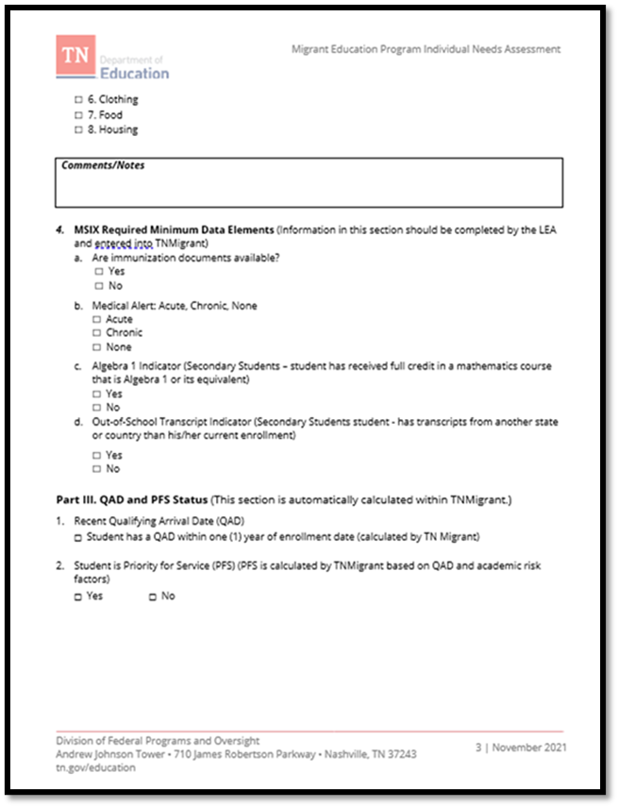
Individual Needs Assessment (INA)
MSCS is required to complete the INA for each certified migrant student within 10 days of the student’s enrollment or identification.
The INA is reviewed by the District as needed and any changes or updates must be shared with teachers serving migratory students.
The district liaison, school designee, and appropriate school-level staff is responsible for completing the INA and the coordination of the services and supports. The liaison works with the school designee to complete the needs assessment.

Slide 19
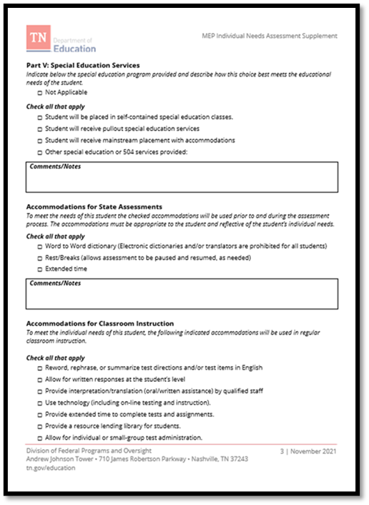
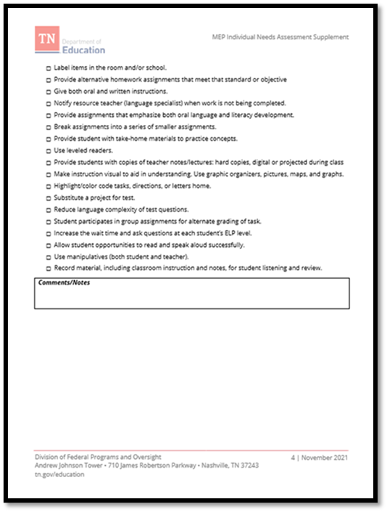
INA Supplement
The INA Supplement is to be completed for migrant EL students.
It is used to identity and track accommodations and interventions for the EL students.
The supplement is completed and updated with the INA.

Slide 20
INA Process – Title I Crate
Access the COE to identify the names of the students at your school.
Download a blank copy of the INA. If the student is an EL, also download the supplement.
Consult with the appropriate staff to compete the INA and supplement (if the student is an EL).
Upload the completed INA and supplement in for each student.
Follow up and updates to the INA and supplement are done as needed, based on identified risk factors.
MSCS
Charter

Slide 21
Services and Supports for Pre-K
The State MEP contractor, Arroyo Research Services (ARS), receives funding from the TDOE to provide services and supports for certified migrant students and families.
The services are coordinated through the Tennessee Migrant Education Program Senior Recruiter.

Slide 22
Contacts
Tonisha Cook
Migrant Education Program Manager & District MEP Liaison
K-12 Services and Supports
cooktl1@scsk12.org
(901) 416-9894
Cristina Villapando
Family Partnership and School Support, Early Childhood
Pre-K Services and Supports (MSCS)
villalpandoc@scsk12.org
Iris Montalvo
Tennessee Migrant Education Program Senior Recruiter
Pre-K Services and Supports (ARS)
iris.montalvo@tn-mep.net
(615) 219-5903

